Slide 1
Pulsoid VRchat World Integration
Hello and welcome to the Pulsoid Vrchat World Integration, Client setup Documentation
In this documentation we use P.V.W.I as an abbreviation for Pulsoid Vrchat World Integration

Slide 2
What Is P.V.W.I and what can it be used for?
P.V.W.I was made for the purpose of integrating the players heart rate data into the World side of VRChat allowing world creators to implement code and game features based around the players heart rate. Some of the following are idea you could implement into VRChat Using P.V.W.I
Mood lighting based upon the average heart rate in the room
Develop a game that uses the players heart rate to determine the difficulty curve of the game
Develop a fitness game for players that will have extra data like heart rate to track the players progression.
Develop anything you like with the heart rate data, it is yours to toy with. Your imagination is the limit.
Within the world of Vrchat or twitch you’ve most likely already seen someone using Pulsoid tech to display their heart rate in a fun and entertaining way. Now why not include that inside of your games in Vrchat??

Slide 3
How Do i Setup P.V.W.I?
01
02
03
Account creation
INSTALL
SETUP
If you already have a pulsoid account you can skip this step
Install the programs needed to get your heart rate data into VRchat
Follow our documentation to see how to allow your heart rate data into vrchat

Slide 4
Account Creation

Slide 5
If you do not already have a pulsoid account we are going to need one, please head over to https://pulsoid.net/ To make an account.
THIS SECTION HAS BEEN LEFT BLANK AS THIS SECTION WILL BE CHANGING ONCE THE PULSOID DESKTOP APPLICATION IS OUT.
—account creation
— installation

Slide 6
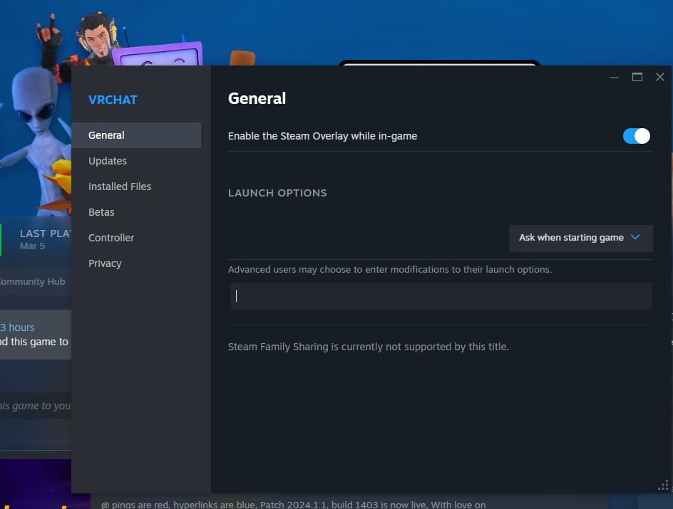
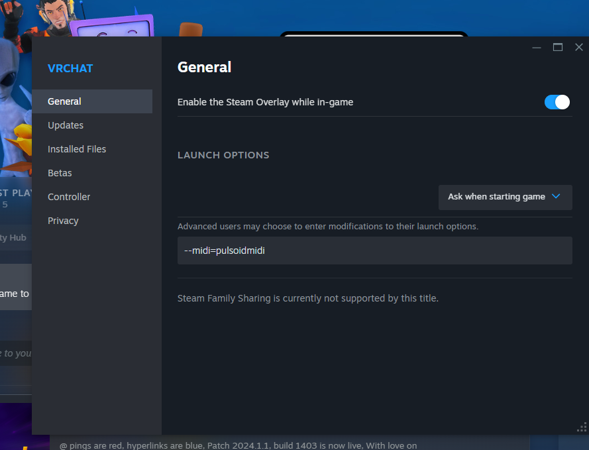
To set up P.V.W.I we will need to head over to steam and right click your VRChat installation, we need to head into properties to set a start up flag so that we can send our heart rate data into the VRChat. Once you have clicked on properties you should see general with an option for steam overlay, under that you should see. “Advanced user may choose to enter modifications to their launch options” inside of this box put in the following:
--midi=pulsoidmidi This will allow our application to put your heart rate data into the game. Now start up your heart rate tracker like normal (if this is your first time please check the pulsoid document on how to set up your heart rate tracker with pulsoid)
Once you have done this we are finished and you can go ahead and boot the game.
— setup

Slide 7
Pulsoid VRchat World Integration
Developed and made By: BassBoostedDuck Discord:
BassBoostedDuck Website: https://bayleighhalifaxwor.wixsite.com/game-dev-portfolio
Please keep this slide for attribution.

